Slide 1
Image Processing Playing cards recognition
Sota Noniwa Q3W2GL

Slide 2
Overview
Goal
Recognizing the number and suit shown on the playing cards based on their images.
Approach
Number
Recognize the number based on the number of suits.
We will find the number of suits by Blob analysis.
Suits
Recognize the suits by polygonal approximation technic.

Slide 3
Assumptions
Playing cards are traditional ones (no extra design)
Cards are from 1 (Ace) to 10
The distance between camera and cards is constant

Slide 4
Approach for recognizing the number of playing cards
by Blob analysis

Slide 5
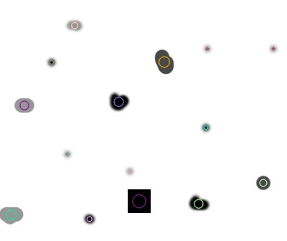
What is a Blob?
A blob refers to a group of connected pixels that share a common property or characteristics, such as color, intensity, texture, or shape.
https://learnopencv.com/blob-detection-using-opencv-python-c/

Slide 6
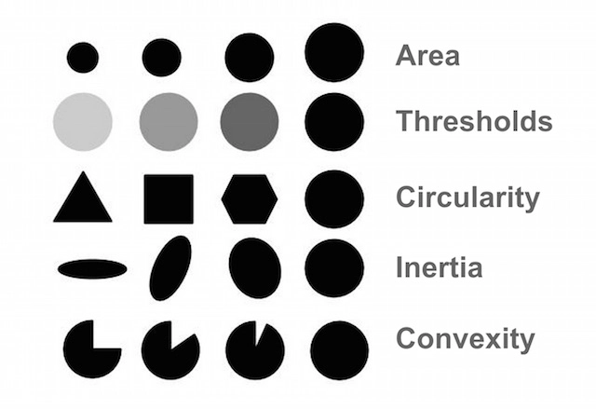
Some parameters for Blob analysis
https://learnopencv.com/blob-detection-using-opencv-python-c/

Slide 7
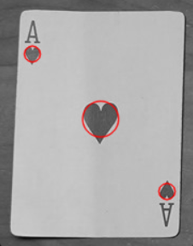
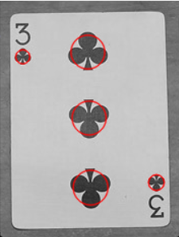
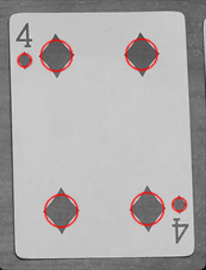
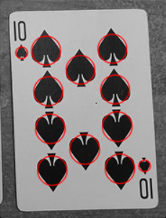
Blobs for playing cards
Number of card = the number of detected blobs - 2

Slide 8
Approach for recognizing the suit of playing cards
by Polygonal approximation

Slide 9
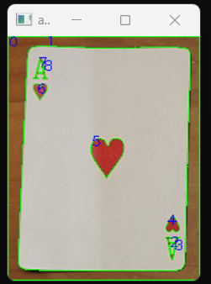
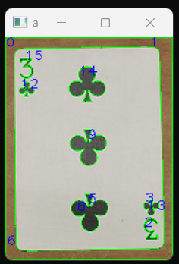
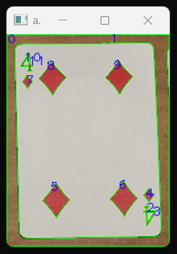
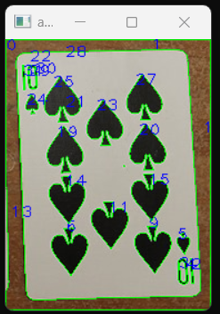
All contours with tree hierarchy
Ignore contour with index 0 (contour of the most external one) and 1 (contour of playing card itself).
Then identify the contour with largest area, namely suit.

Slide 10
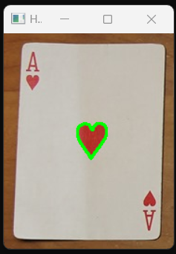
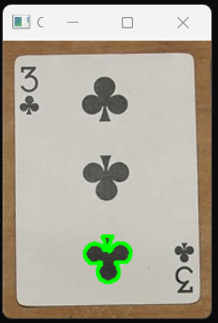
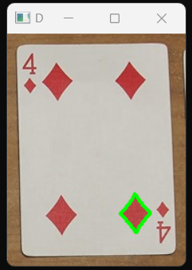
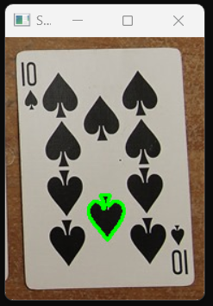
Result

Slide 11
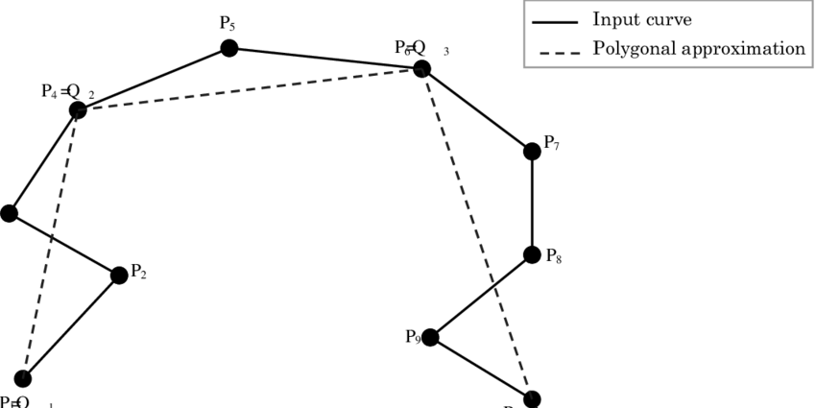
What is a polygonal approximation?
A contour polygon is a rough contour that approximates the shape of an object or region in an image. It is obtained by fitting a polygon to a set of contour points that define the boundary of the object or region.
https://www.researchgate.net/figure/Example-of-polygonal-approximation_fig1_27706786

Slide 12
Polygonal approximation with approxPolyDP function
void cv::approxPolyDP (InputArray curve,
OutputArray approxCurve,
double epsilon,
bool closed
)
The crucial thing here is that the smaller epsilon creates more accurate contours. If epsilon is small, it means the segment between points is small.

Slide 13
First approximation with rough polygon
Epsilon = perimeter of contour * 0.02
 | The number of corners
Epsilon | Heart | Diamond | Spade | Club
perimeter * 0.02 | 9 | 4 | 9 | 15
 | 10 | 4 |  | 15
 | 10 |  |  | 14
 |  |  |  | 14
min | 9 | 4 | 9 | 14
max | 10 | 4 | 9 | 15
We will determine the suit type based on the number of corners.
However, heats and spades have similar number of corners.
Therefore, we need more accurate approximation for those two suits so that we can make distinguish.

Slide 14
Second approximation with smoother polygon
Epsilon = perimeter of contour * 0.001 (for Heats and Spades)
 | The number of corners
Epsilon | Heart (0.001) | Diamond (0.02) | Spade (0.001) | Club (0.02)
perimeter * (0.02 or 0.001) | 59 | 4 | 67 | 15
 | 57 | 4 |  | 15
 | 63 |  |  | 14
 |  |  |  | 14
min | 57 | 4 | 67 | 14
max | 63 | 4 | 67 | 15

Slide 15
References
Blob Detection Using OpenCV (Python, C++)
https://learnopencv.com/blob-detection-using-opencv-python-c/
Structural Analysis and Shape Descriptors
https://docs.adaptive-vision.com/current/studio/filters/StructuralAnalysisandShapeDescriptors/index.html
LEARN OPENCV C++ in 4 HOURS | Including 3x Projects | Computer Vision
https://youtu.be/2FYm3GOonhk
by Murtaza's Workshop - Robotics and AI
Contour Detection In OpenCV 101
https://youtu.be/JfaZNiEbreE
https://youtu.be/wEZuYRyTcV0
https://youtu.be/g7JegWRtMi8
by Bleed AI Academy

